Slide 1
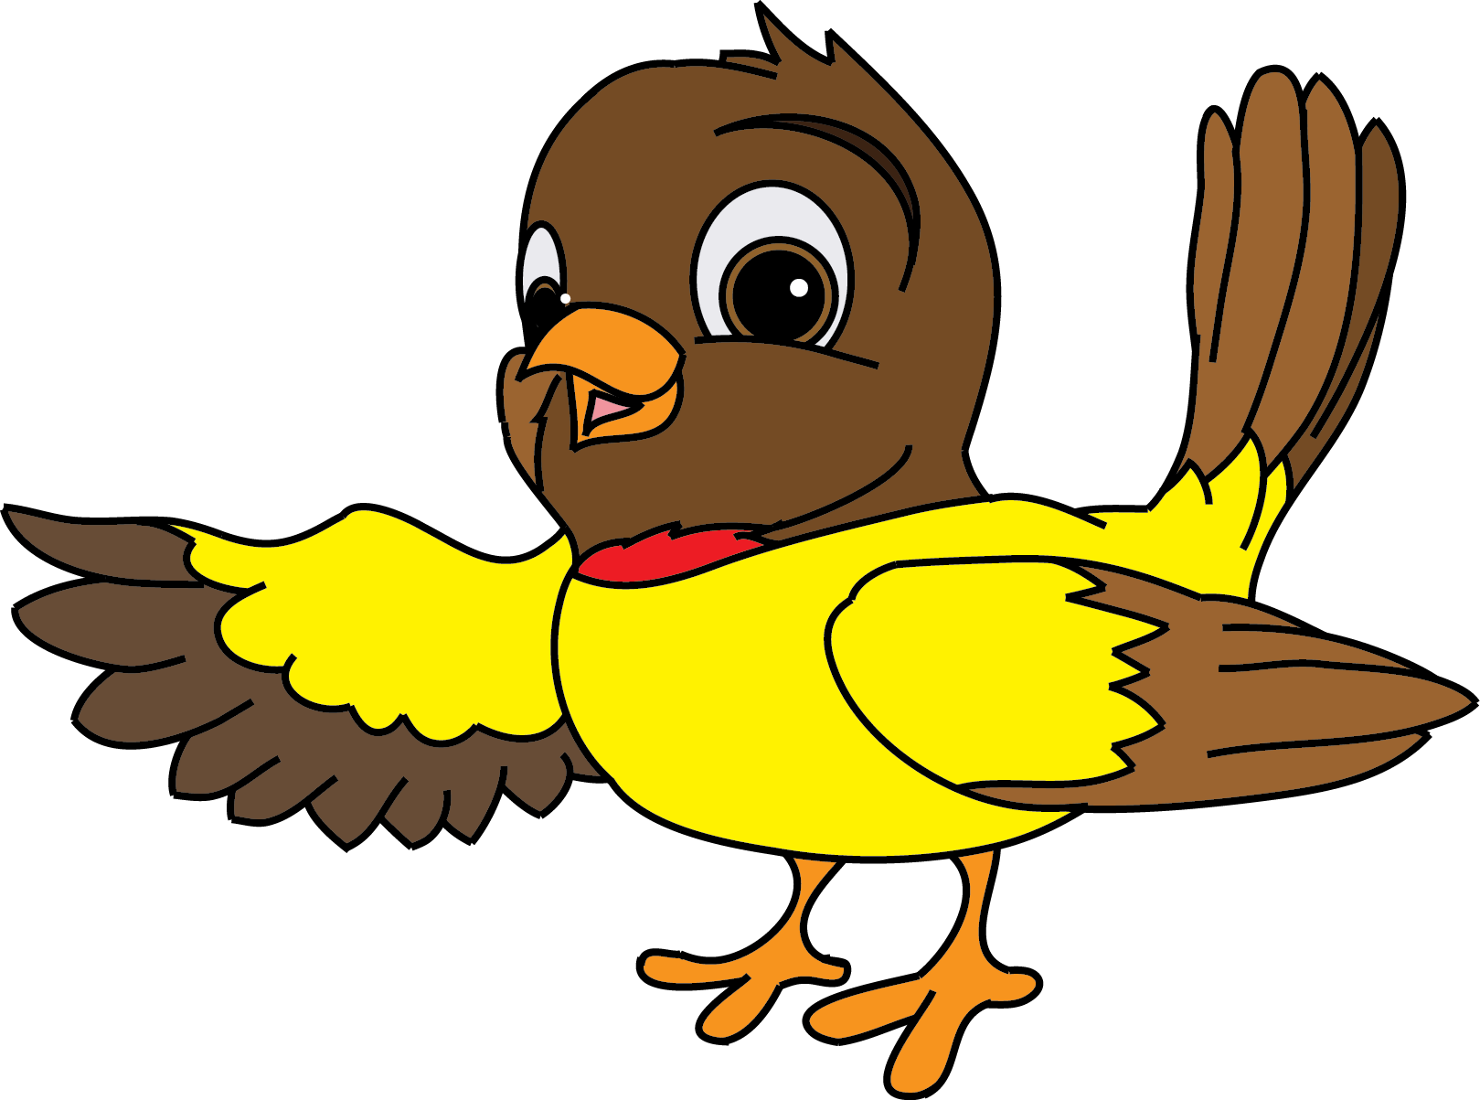
Year 1 Phonics Screening!
What is the Year 1 Phonics Screening Check?
The Phonics Screening Check is meant to show how well your child can use the phonics skills they’ve learned up to the end of Year 1, and to identify students who need extra phonics help. The Department for Education defines the checks as “short, light-touch assessments” that take about four to nine minutes to complete.
How do children complete the Phonics Screening Check?
The checks consist of 40 words and non-words that your child will be asked to read one-on-one with a teacher. Non-words (or nonsense words, or pseudo words) are a collection of letters that will follow phonics rules your child has been taught, but don’t mean anything – your child will need to read these with the correct sounds to show that they understand the phonics rules behind them.
Video link - https://youtu.be/h-o3cQKjU18
The 40 words and non-words are divided into two sections – one with simple word structures of three or four letters, and one with more complex word structures of five or six letters. The teacher administering the check with your child will give them a few practice words to read first – including some non-words – so they understand more about what they have to do. Each of the non-words is presented with a picture of a monster / alien, as if the word were their name (and so your child doesn't think the word is a mistake because it doesn't make sense!).
When will the Year 1 Phonics Screening take place in 2023?
Schools will administer the Year 1 Phonics Screening Check the week beginning Monday 12th June 2023.
Does my child have to take it?
Yes – all students in Year 1 in England must take the screening check.
What will my child’s score mean?
Your child will be scored against a national standard, and the main result will be whether or not they fall below, within or above this standard.
In 2013, 2014, 2015, 2016, 2017, 2018, 2019 and 2022 the "pass threshold" was 32, which means children had to read at least 32 words out of 40 correctly. The threshold mark is communicated to schools at the end of June, after the test has been taken, so that teachers can mark the Check.
You will be told how your child did, but schools’ results will not be published. If your child’s score falls below the standard, they will be given extra phonics help and can re-take the Phonics Screening Check in Year 2.
How can I help my child prepare?
You can help your child prepare for their Phonics Screening Check by going over the phonics they’ve learned in Reception and Year 1 using RWI sound books. Read new books and stories with them where they will be introduced to new words that they’ll have to sound out using their ‘Fred talk’. Practice alien words using resources available on the DFE website and using the QR code given by your class teacher. https://www.gov.uk/education/phonics

