Slide 1
Year 1 Phonics Screening
Parents Information Meeting January 2023

Slide 2
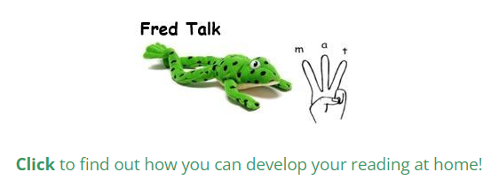
Reading support
If you missed the meeting last year please look on the Robins class webpage to view the PowerPoint we delivered, in which we shared strategies to support reading and phonics at home. We will be doing another one later this year.

Slide 3
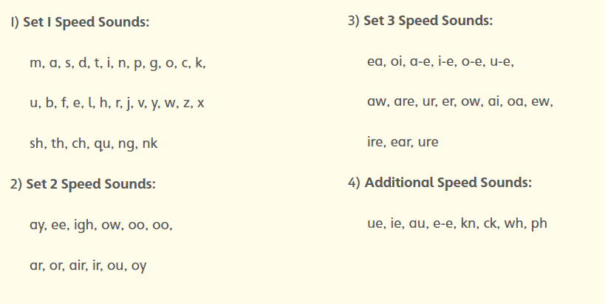

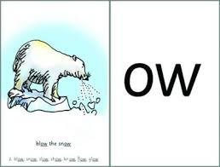
Read, Write, Inc.

Slide 4
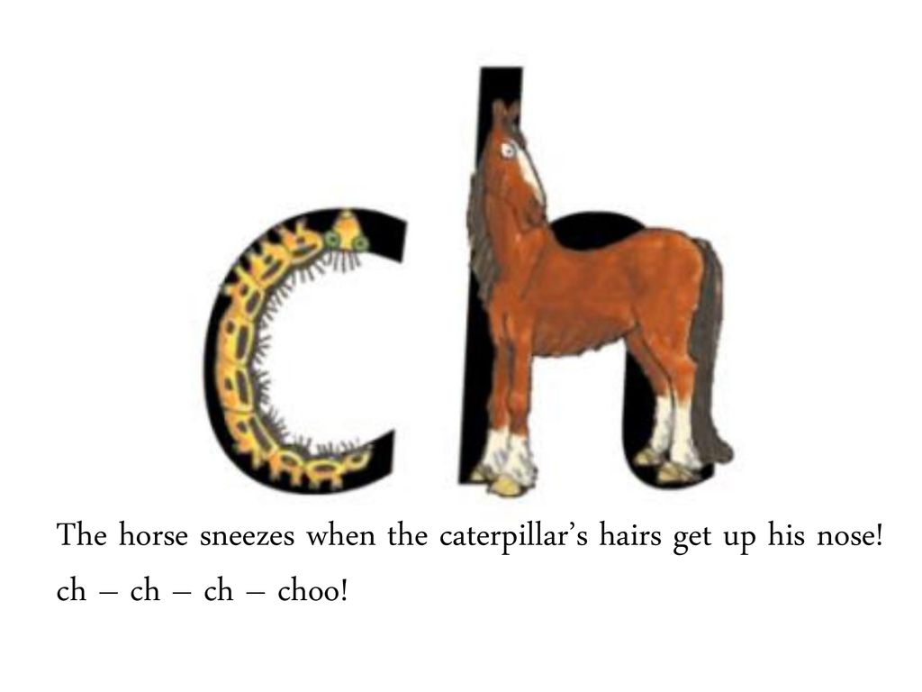
Sounds written with two letters:
sh th ch qu ng nk ck
Any questions?
special friends

Slide 5
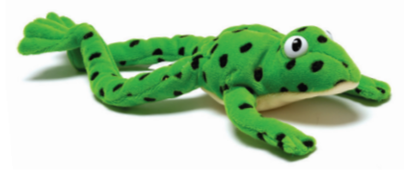
Sound Blending Set 2&3
p-l-ay play
b-ee-n been
n-igh-t night
Fred
Fred talk
then
Fred in your head

Slide 6
Phonics Screening
We have already done 2 practice assessments.
It is all very low key, presented in a fun and enjoyable way for the children.
They’re encouraged to try their best and are helped with any they don’t know (however this doesn’t count towards their score).
Assessment is usually completed at the end of May/start of June.
Data submitted nationally.
You will receive the results at the end of the year. A number out of 40. The pass mark changes every year but it is roughly between 32 and 36.
Please don’t worry about it but there are things to do at home that can help ☺
You can find passed papers on the DFE website - https://www.gov.uk/government/publications/phonics-screening-check-2022-materials

Slide 7
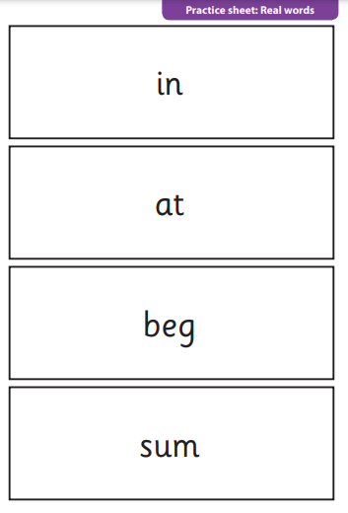
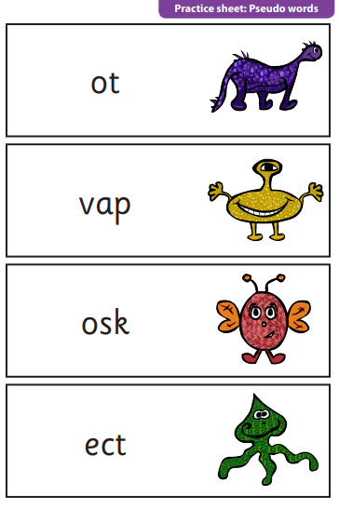
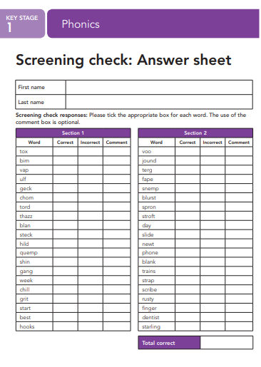
What does it look like? What do they have to do?

Slide 8
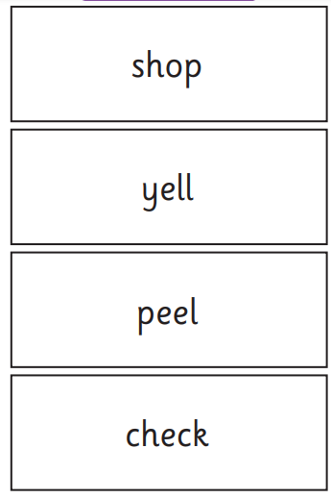
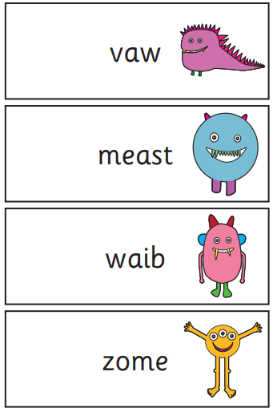
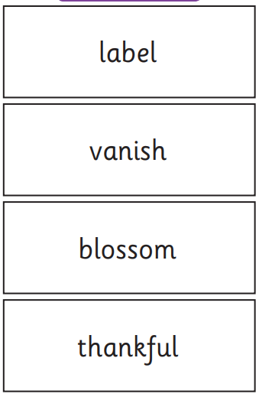
Recognising ‘special friends’ and ‘chatty friends’ and Fred talk!

Slide 9
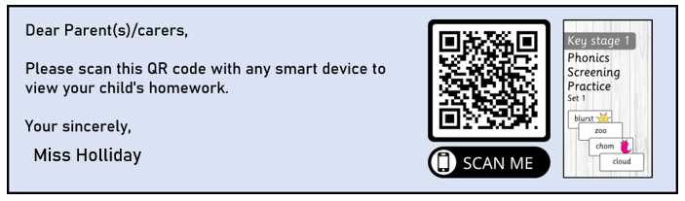
QR Codes
In the handout you have there are a selection of QR codes, if you scan the QR on your phone it will take you to a alien word practice paper that you can do with the children at home. This is typically the section children find more challenging.

Slide 10

Any Questions?

