Slide 1


Slide 2
Who are we?
Mr Coy – Class Teacher
Mrs Tagg – Class Teaching Assistant (AM only)
Miss Arthurs - 1:1 Teaching Assistant
Mrs Booton – Tuesday AM
Delta Sports – PE (Tuesday PM)

Slide 3
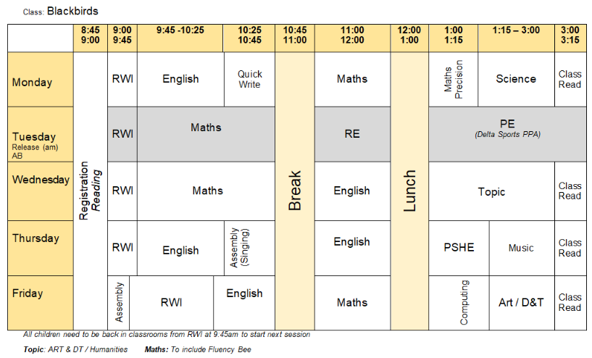

Slide 4
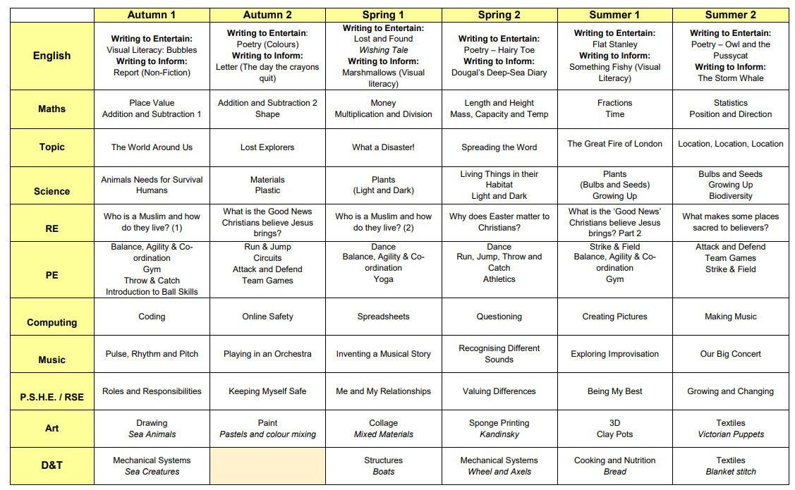
What will we be learning?

Slide 5
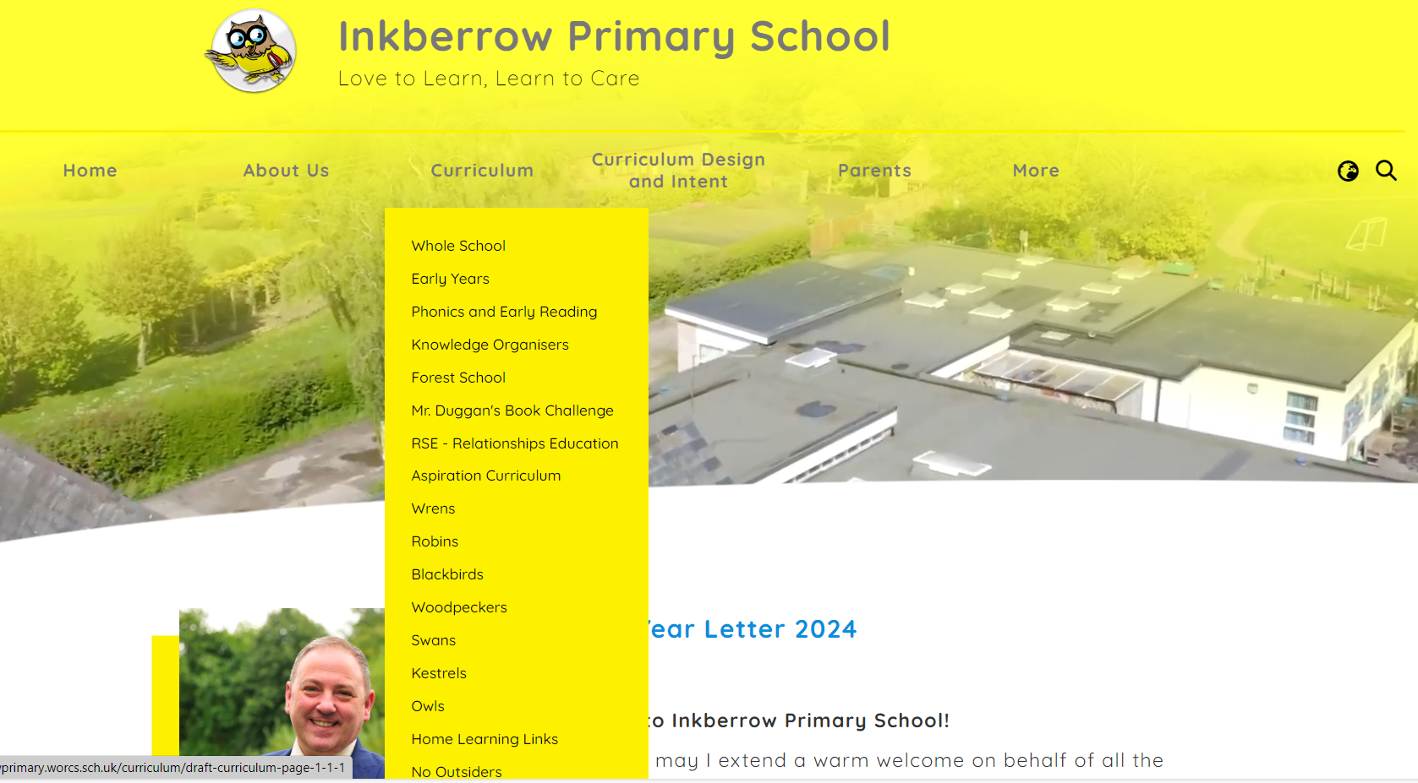

Slide 6
Classroom Expectations
Become more responsible. (Looking after belongings and equipment)
Become more independent. (Reading timetables, choosing resources that suit them)
Take ownership of learning. (Regular contributions, be ready to learn)
Give it a go and make mistakes.

Slide 7

Homework
Around 15 minutes per day
Be inquisitive:
What do you think will happen next?
I wonder why the character did that …
How is the character feeling?
Can you think of another story like this?
Bronze 100 book challenge
Is so important for all areas of the curriculum.
Daily Phonics sessions using RWI.

Slide 8
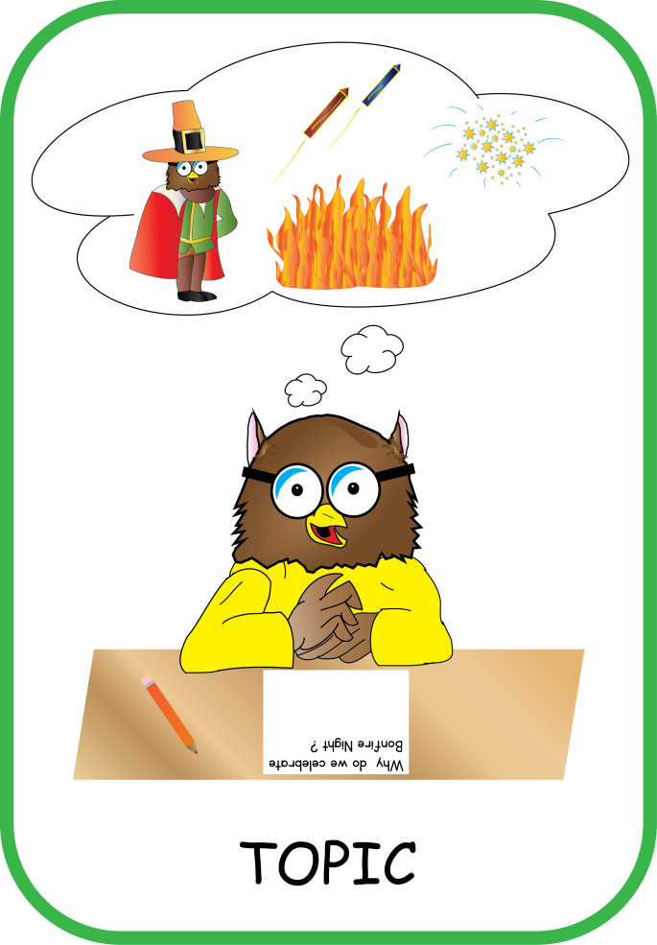
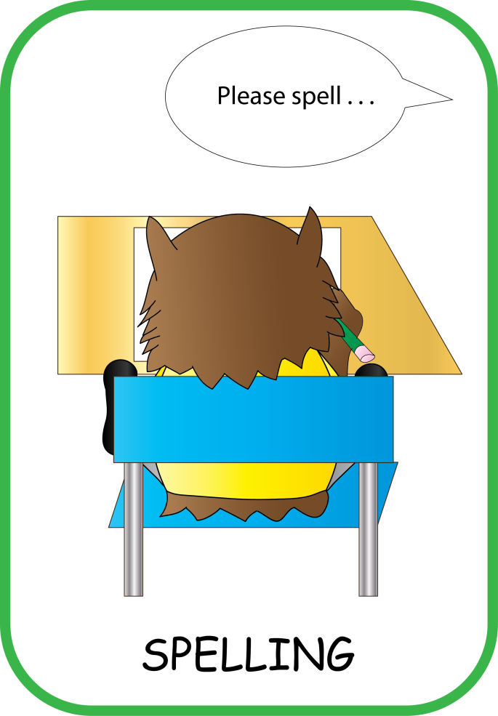
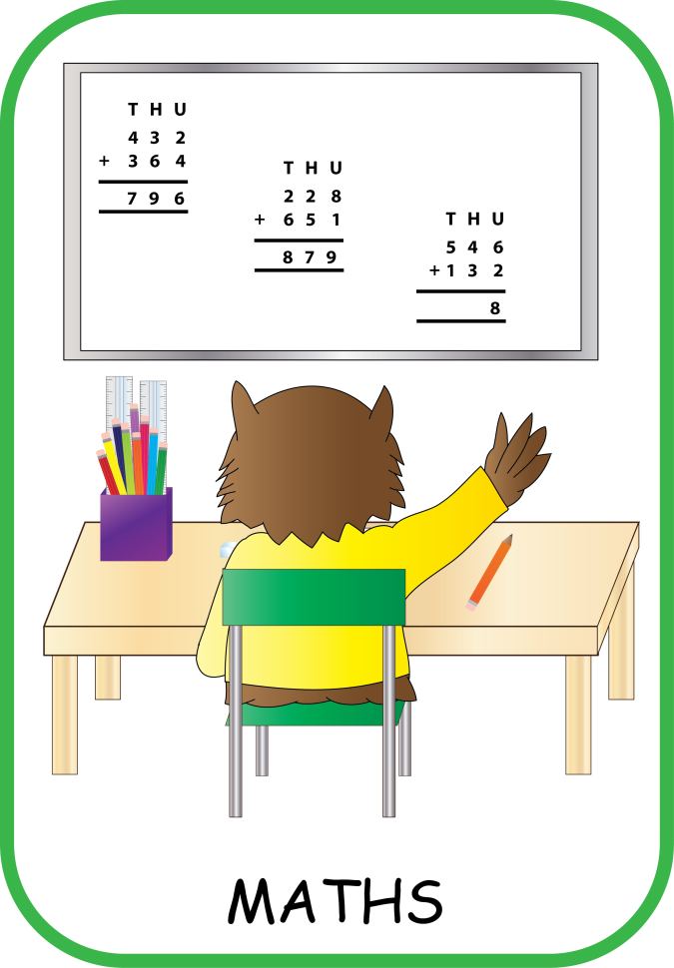
Homework

Slide 9
Communication
Reading Diary – Please encourage your child to bring them to us if there is anything that requires a reply.
At the beginning or end of the school day after children are in/dismissed.
Via the school office (email or telephone)
Family Helpers
Trips
Forest School
Reading/Group Class Activities
Aspiration Days
Any Questions?

