Slide 1


Year 3

Slide 2
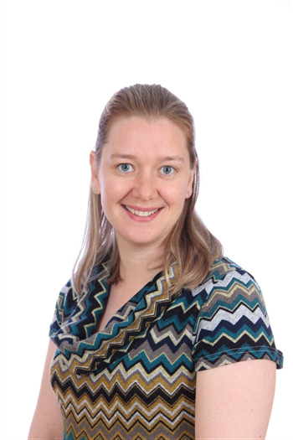
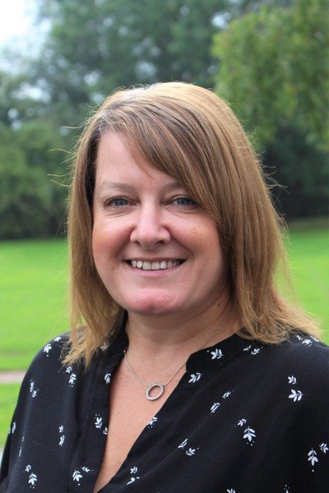
Meet the team
Mrs Ellis (Class Teacher) Mrs Martini (Class Teaching Assistant)

Slide 3





Expectations in Year 3
Focus on independence as we step up into Key Stage 2.
We set a good example to Wrens, Robins and Blackbirds.
Class Charter – class agreement of rules which we as a whole class will follow.
Good Learners:
- arrive on time
- are organised
- positive attitude
- 5 Inky Owl Values

Slide 4

Home School diaries
It is the children’s responsibility to record all homework, reading, spellings and additional information.
They need to be in school every day. Children will put them into the basket as they set up for the day.
Parents to sign weekly and use these to communicate with myself. Please tell your child to let us know if there are any messages.

Slide 5

Reading
Reading in Key Stage 2 is equally important as lower years. As well as daily reading at home, the children benefit from reading buddies across the school.
Children will be able to choose their own books on their set book band and from Mr Duggan’s Book Challenge shelves. We start the Silver Challenge in Year 3 – Year 4. Any chapter book counts.
Half termly class reading challenges to complete based on our current topic.
Please use the reading record within the diary to record daily reading and comments you wish to share.
There is a big focus on comprehension in year 3. When listening to your child read, ask searching questions to
check for their understanding of the text.
Any parents, grandparents or family wishing to volunteer to listen to us read either on a weekly or ad-hoc
basis, please let me know.

Slide 6
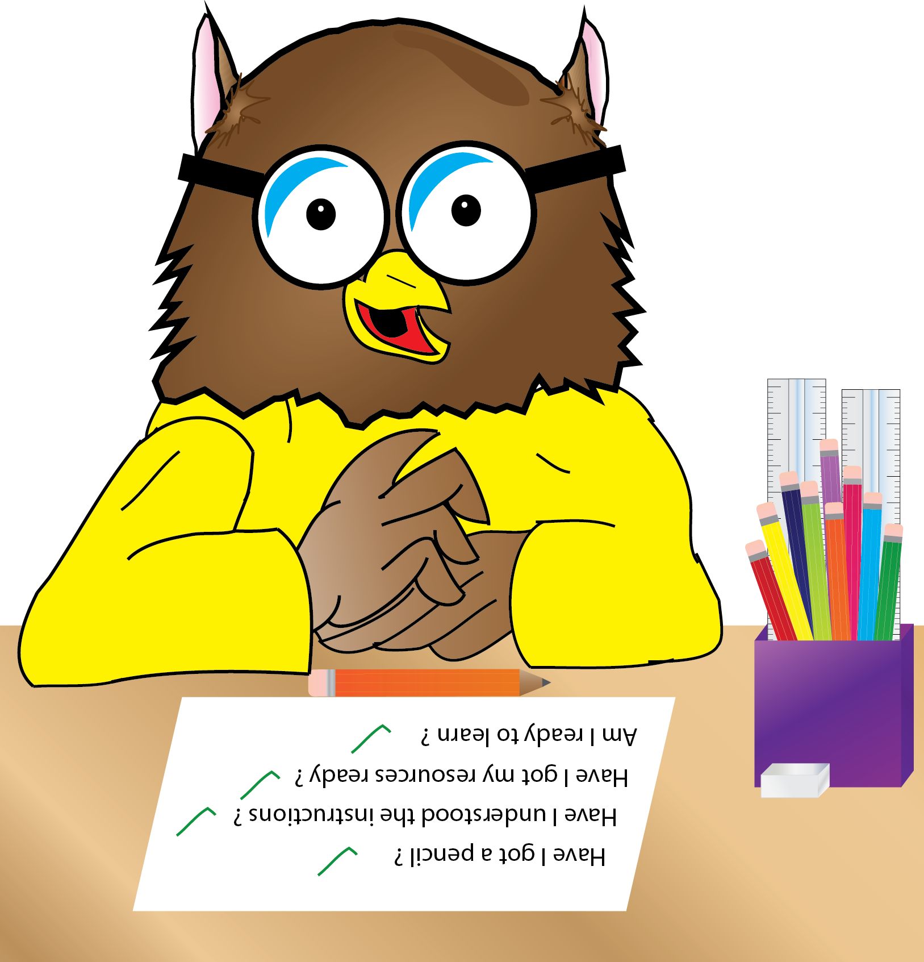
Homework
Weekly homework consists of:
Maths – Set fortnightly on Friday, alternating with Spelling homework. This will be alternated between a written piece and online using the MathsShed/TTRockstars platforms. These are monitored by Mrs Ellis.
Homework consolidates our learning and is not new coverage. If you are unsure of the methods used to support, please ask. Our school calculation policy is on the website.
Spelling – Set fortnightly with tests on alternate Fridays. All spelling books to be returned the Wednesday before to allow time for marking. Our year 3 & 4 statutory spellings will be sent out to see the order taught.
Times Tables – Additional homework tested through our ‘Minute a Day’. When practicing at home, please jumble them up, mix division and missing numbers. We do not check in order. This year we will be consolidating our number bonds, 2s, 5s and 10s from year 2 and learning our 3s, 4s and 8s.
Topic – Projects linked to the current topic with a mix of teacher directed and free choice options.
Reading – Daily 20 minutes minimum. Half termly reading challenges to complete. Mr Duggan’s book challenge.

Slide 7
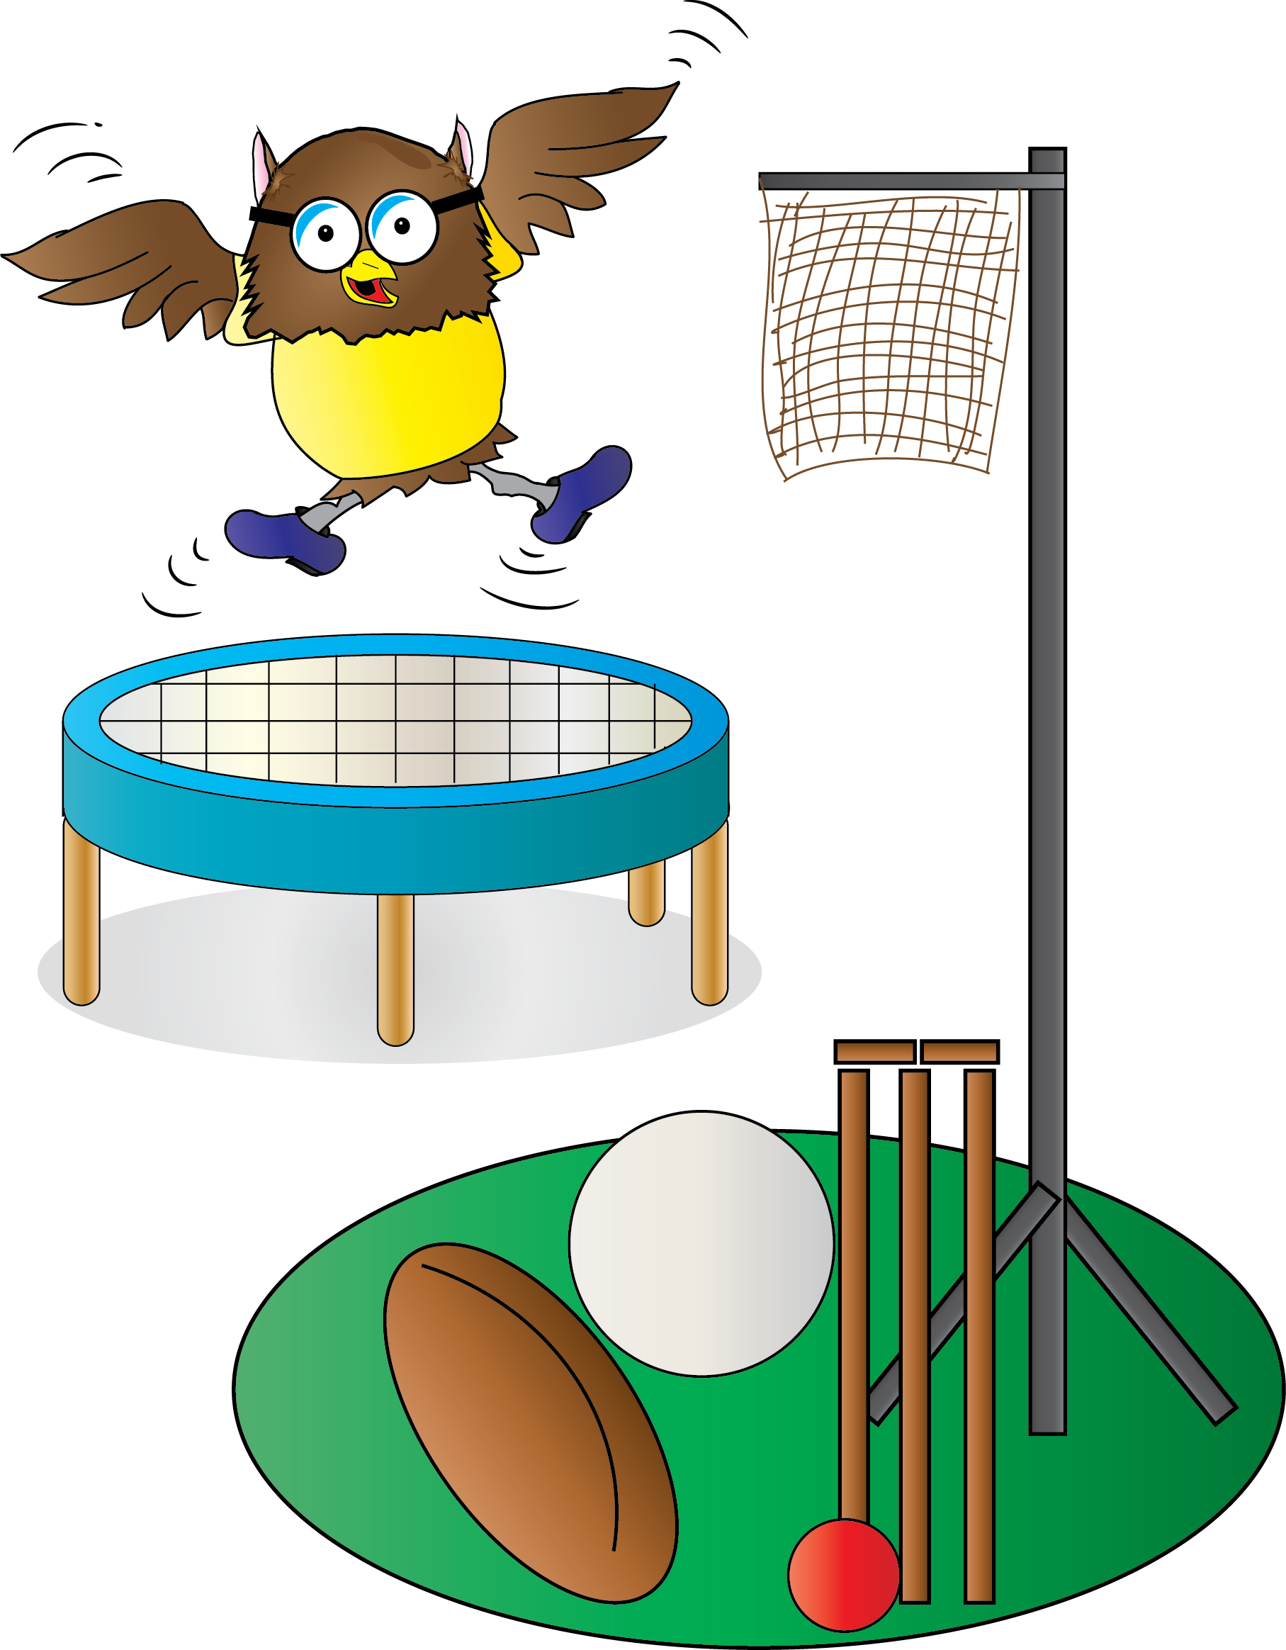
PE
This year, Woodpeckers will be having their PE sessions as a full afternoon on Fridays.
Please make sure the children come into school wearing the correct school PE kit.

Slide 8



Events through the year

Slide 9

Any questions?

