Slide 1
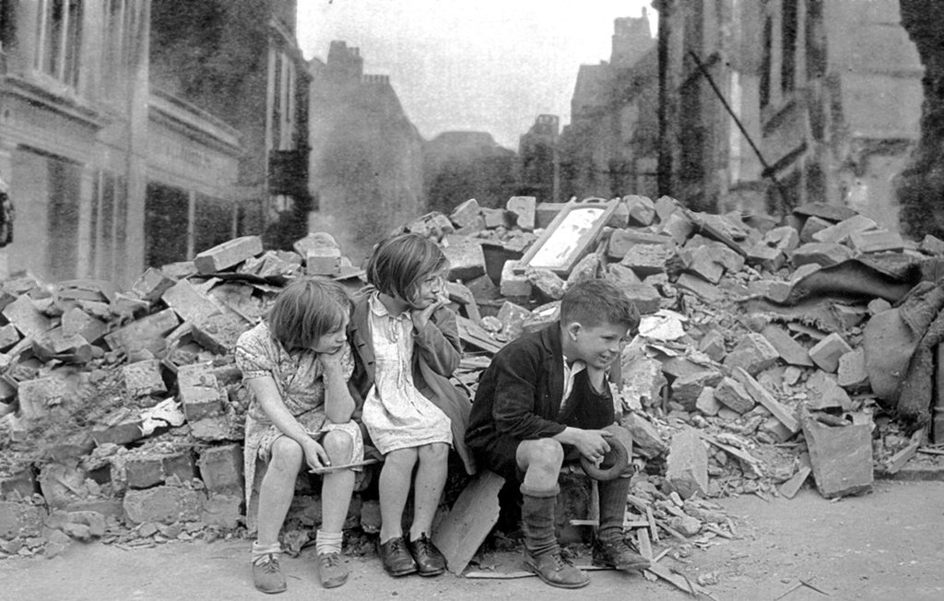

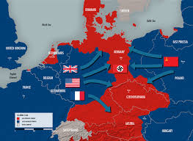
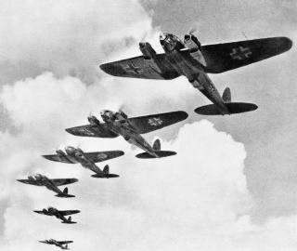
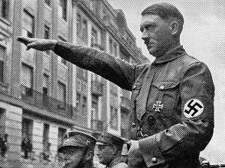
Autumn 2: World War II
Key Questions
Why did Britain have to go to war in 1939?
Why it was necessary for children to be evacuated and what was evacuation really like?
How was Britain able to stand firm against the German threat?
How did Britain cope with the effect of war on the Home Front?
How did people manage to carry on normal life during the war and how do we know?
Why it so difficult is to be sure what life on the Home front was really like?
What was VE day really like?
Communication and Technology
An Enigma machine is a famous encryption machine used by the Germans during WWII to transmit coded messages. An Enigma machine allows for billions and billions of ways to encode a message, making it incredibly difficult for other nations to crack German codes during the war — for a time the code seemed unbreakable. Alan Turing and other researchers exploited a few weaknesses in the implementation of the Enigma code and gained access to German codebooks, and this allowed them to design a machine called a Bombe machine, which helped to crack the most challenging versions of Enigma. Some historians believe that the cracking of Enigma was the single most important victory by the Allied powers during WWII. Using information that they decoded from the Germans, the Allies were able to prevent many attacks. However, to avoid Nazi suspicion that they had insight to German communications, the Allies had to allow some attacks to be carried out despite the fact that they had the knowledge to stop them.
Alan Turing
During the Second World War, Alan Turing worked at the Government Code and Cipher School at Bletchley Park – the forerunner of GCHQ – where he devised the techniques which cracked the German Enigma code. He is widely seen as the father of computer science and artificial intelligence and is credited with helping to shorten the course of the war.
Turing was born in 1912 in a nursing home in Paddington, London, another biographer Andrew Hodges has said. Science was "an extra-curricular passion", which led him to become an undergraduate at King's College.
1938 March 12 - Hitler blends the country of Austria into Germany. This is also called the Anschluss.
1939 September 1 - Germany invades Poland. World War II begins.
1939 September 3 - France and Great Britain declare war on Germany.
1940 April 9 to June 9 –
Germany invades and takes control of Denmark and Norway.
1940 May 30 - Winston Churchill becomes leader of the British government.
1940 June 10 - Italy enters the war as a member of the Axis powers.
1940 July 10 - Germany launches an air attack on Great Britain. These attacks last until the end of October and are known as the Battle of Britain.
September 22 - Germany, Italy, and Japan sign the Tripartite Pact creating the Axis Alliance. 1941
1941 December 7 - The Japanese attack the US Navy in Pearl Harbour. The next day the US enters World War II on the side of the Allies.
1942 June 4 - The US Navy defeats the Japanese navy at the Battle of Midway.
1942 July 10 - The Allies invade and take the island of Sicily.
1943 September 3 - Italy surrenders to the Allies, however Germany helps Mussolini to escape and set up a government in Northern Italy
1944 June 6 - D-day and the Normandy invasion. Allied forces invade France and push back the Germans.
1944 August 25 - Paris is liberated from German control
1944 December 16 - The Germans launch a large attack in the Battle of the Bulge. They lose to the Allies sealing the fate of the German army.
1945 February 19
US Marines invade the island of Iwo Jima. After a fierce battle they capture the island.
1945 April 30 - Adolf Hitler commits suicide as he knows Germany has lost the war.
1945 May 7 - Germany surrenders to the Allies.
1945 August 6 - The United States drops the Atomic Bomb on Hiroshima, Japan. The city is devastated.
.

Slide 2
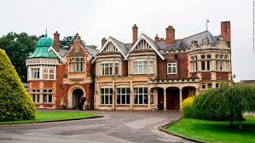
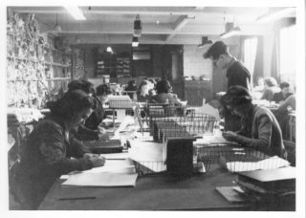

Alan Turing: Alan Turing was a brilliant British Mathematician who took a leading role in breaking Nazi ciphers during WWII.
Holocaust: The Holocaust (The Shoah) was the attempt by the Nazis and their collaborators to remove all the Jews in Europe.
Pearl Harbour: On the morning of 7 December 1941, at 7.55am local time, 183 aircraft of the Imperial Japanese Navy attacked the United States Naval base at Pearl Harbor on the island of Oahu, Hawaii. ... Within two hours, 18 US warships had been sunk or damaged, 188 aircraft destroyed and 2,403 American servicemen and women killed.
Conscription: compulsory enlistment for state service, typically into the armed forces
Enigma Code: The Enigma machine is an encryption device developed and used in the early- to mid-20th century to protect communication Enigma has an electromechanical rotor mechanism that scrambles the 26 letters of the alphabet
Winston Churchill: As Prime Minister (1940–45) during most of World War II, Winston Churchill rallied the British people and led the country from the brink of defeat to victory. He shaped Allied strategy in the war, and in the war's later stages he alerted the West to the expansionist threat of the Soviet Union.
Joseph Stalin: (1878 – 1953) was the ruler of the Soviet Union from the mid-1920s until his death in 1953. Blitz The Blitz: (September 1940–May 1941), nighttime bombing raids against London and other British cities by Nazi Germany during World War II. The raids followed the failure of the German Luftwaffe to defeat Britain's Royal Air Force in the Battle of Britain
Evacuation: Evacuation means leaving a place. During the Second World War, many children living in big cities and towns were moved temporarily from their homes to places considered safer, usually out in the countryside.The first official evacuations began on September 1 1939, two days before the declaration of war
Appeasement: Spurred by voters who demanded "No more war", the leaders of Britain, France, and the United states tried to avoid conflict through diplomacy. This resulted in weak western Governments and this allowed Hitler and other countries to take advantage and cause war
Dictator: a ruler with total power over a country, typically one who has obtained control by force.
Top Facts!
World War 2 was a battle between two groups of countries Before World War 2 began, Germany was ruled by a man named Adolf Hitler During the course of the war, German forces advanced through Europe By the summer of 1941 they had invaded France, Belgium, Holland, Luxembourg, Denmark, Norway, Greece, Yugoslavia and the USSR Some countries remained ‘neutral’ in World War 2 , Such countries were Spain, Sweden and Switzerland – who chose not to join either side Around 64 million people died in World War 2 The group most heavily targeted by the Nazis were the Jews Around six million Jewish people were killed during World War 2 in one of history’s most terrible events – the Holocaust. Racist in his views, Hitler blamed Jewish people for Germany losing World War I and claimed they were dangerous to German people and society. | Around the same time that Germany fought for power in Europe, Japan wanted to control Asia and the Pacific. In 1937 (before World War 2 had officially begun) under Emperor Hirohito, Japan attacked China, bringing the two nations into years of conflict. The US didn’t join the war until 1941, when Japan attacked the United States at their Naval Base at Pearl Harbor in Hawaii. On 8 December 1941 (the very next day), the US declared War on Japan and, in turn, its German allies. The Germans surrendered on 8 May 1945 In 1944, an Allied army crossed from Britain to free France from Nazi rule. One year later, Allied armies invaded Germany, forcing the Germans to surrender. After nuclear attacks on Japan’s major cities Hiroshima and Nagasaki, Japan also surrendered to Allied forces in August the same year. World War 2 had ended.
Bletchley Park
Bletchley Park, once the top-secret home of the World War Two Codebreakers is now a vibrant heritage attraction.
Useful Links
https://bletchleypark.org.uk/our-story/the-challenge/enigma
https://www.natgeokids.com/uk/discover/history/general-history/world-war-two/
https://www.biographyonline.net/military/people-world-war-two.html
https://www.popularmechanics.com/military/g2652/most-important-battles-world-war-ii/

