Slide 1
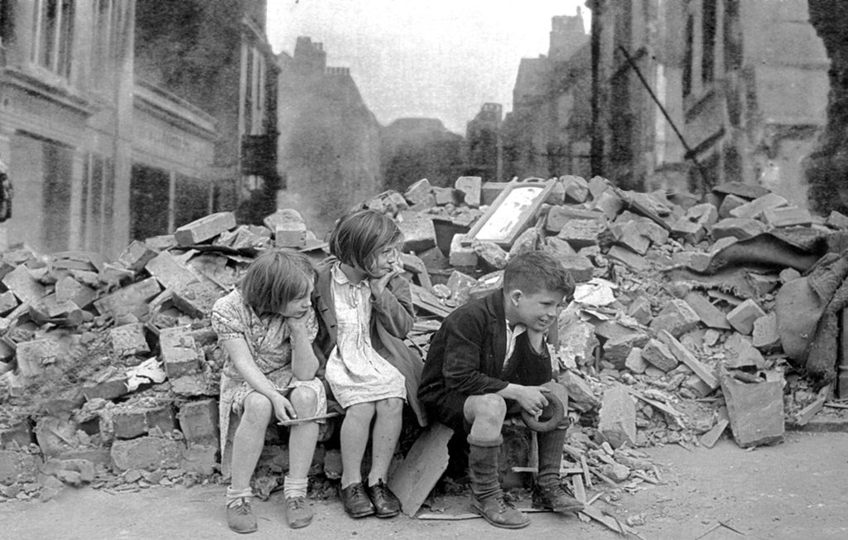
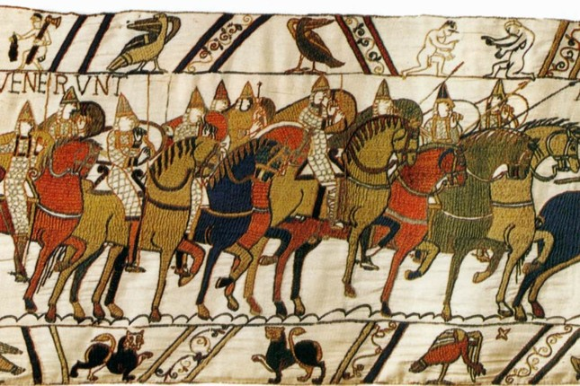

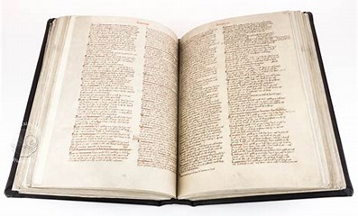
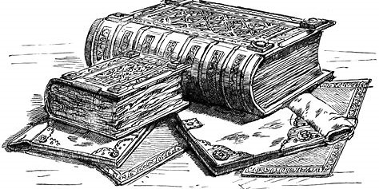
Spring Two: Norman Conquests
Bayeux Tapestry
an embroidered cloth, about 70 metres (230 feet) long, illustrating events leading up to the Norman Conquest and made between 1066 and 1077 for the bishop of Bayeux in Normandy
Key Questions
Did any King possess ‘the divine right’ to rule?
Why was the Battle of Hastings so important for British History?
What was the most important Norman legacy?
Why did Harold lose the battle of Hastings?
Was William the Conqueror a Democrat or a Dictator?
Are elements of the Feudal system still apparent today?
What is the legacy of the Domesday book?
Top Norman Facts!
William of Normandy is mostly known by his nickname William the Conqueror. The Battle of Stamford Bridge between the English and the Norwegians is considered by some historians to mark the end of the Viking Age. Norman rule had a lasting effect in England. Many English nobles left the country fleeing to Ireland, Scotland, and the Scandinavian countries. The Normans instituted many new laws and brought the French culture with them The Domesday Book was a complete written record of property ownership across England, and was completed in less than a year. At the time it was called the Winchester Book, but later became better known as the Domesday Book. | The Normans ruled England for about 300 years. The elite English troops of King Harold II were called the housecarls. The Normans invaded England in 1066 because they wanted to have Norman king in England after the Anglo-Saxon king died. The Bayeux Tapestry is a large piece of embroidery that shows scenes from the Norman Conquest. William decided to fight Harold for the crown. He gathered about 5,000 knights on the coast of Normandy, directly across the English Channel from England. His army landed in England on September 28.
1
.
January 1066
Edward the Confessor died, and Harold II became king
25 September 1066
The Battle of Stamford Bridge took place near York, between the Anglo-Saxons and Viking invaders led by Harald Hardrada
14 October 1066
King Harold was killed in the Battle of Hastings, making William the Conqueror the new Norman king
25 December 1066
William the Conqueror was crowned at Westminster Abbey, making him King William I
1399
Henry Bolingbroke took over the throne and became the first king from the house of Lancaster (Henry IV), ending the rule of Norman kings

Slide 2
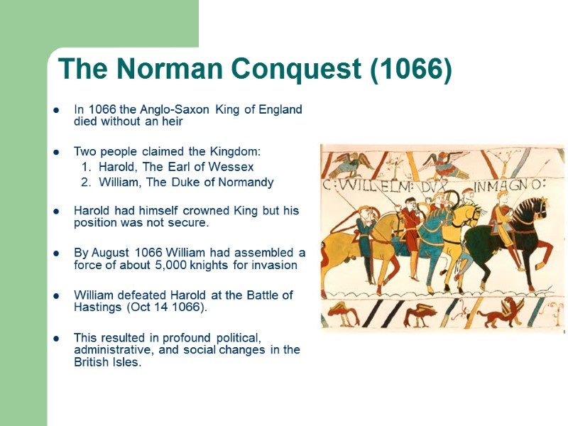
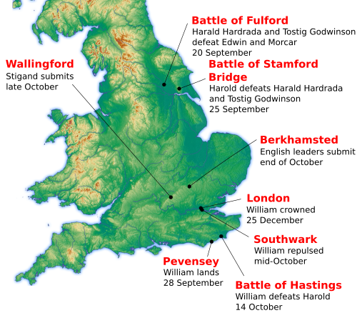
Spring Two: Norman Conquests
Key Battles!
Bayeaux Tapestry an embroidered cloth, about 70 metres (230 feet) long, illustrating events leading up to the Norman Conquest and made between 1066 and 1077 for the bishop of Bayeux in Normandy
Norman: a member of a people of mixed Frankish and Scandinavian origin who settled in Normandy from about ad 912 and became a dominant military power in western Europe and the Mediterranean in the 11th century
Edward the Confessor: King of England, married to Harold's sister, Edith. He died in January 1066 without an heir
King Cnut: King of England 1016-1035. Cnut was the King of Denmark, who exploited the fragmented nature of England to seize the throne in 1016. He ruled with the help of the English Earls Godwine and Leofric
William of Normandy: had a very shaky claim to the English throne, but what he did have in his favour was a dukedom full of Norman knights, all eager for a share of newly conquered land.
Harold Godwinson: Son of Godwine and Earl of Wessex. Harold was very powerful by 1066. He was possibly richer than the King, and had established alliances with all the major magnates of England.
Edwin and Morcar: Grandsons of Leofric, Earls of Mercia and Northumbria. Previously arch enemies of the Godwinsons, they seem to have made a deal with Harold in 1065, who helped Morcar into the Earldom of Northumbria in return for their support when Edward died
Tostig: Brother of Harold and ex-Earl of Northumbria. Deposed by the Northumbrians in favour of Morcar, Tostig fled to Norway, where he plotted revenge against his brother Harold
Harald Hardrada: King of Norway. Persuaded to invade Northumbria in 1066 by Tostig. Their victory at Fulford and their defeat and death at Stamford Bridge probably ensured the success of William's invasion at Hastings.
Domesday Book: a complete written record of property ownership across England, and was completed in less than a year. At the time it was called the Winchester Book, but later became better known as the Domesday Book
Feudal system: a way of structuring society around relationships that were derived from the holding of land in exchange for service or labor
The Battle of Stamford Bridge: took place at the village of Stamford Bridge, East Riding of Yorkshire, in England, on 25 September 1066, between an English army under King Harold Godwinson and an invading Norwegian force
The Battle of Hastings: fought on 14 October 1066 between the Norman-French army of William, the Duke of Normandy, and an English army under the Anglo-Saxon King Harold Godwinson, beginning the Norman conquest of England.
The divine right of kings: A king is chosen to rule by God
Culture and Society
The conquest saw the Norman elite replace that of the Anglo-Saxons and take over the country's lands, the Church was restructured, a new architecture was introduced in the form of motte and bailey castles and Romanesque cathedrals, feudalism became much more widespread.
The rulers of Normandy (in the north of present-day France) in the 11th century were originally from Scandinavia. Normans were originally 'north-men'. By the 11th century they had developed quite a different society from the world of the Vikings that they belonged to a hundred years before
Useful Links
Middle Ages for Kids: Norman Conquest (ducksters.com)
Norman conquest of England Facts for Kids (kiddle.co)
The Normans: Facts & Information for Kids - History for Kids
C8kyfivXYAAHErv.jpg (1200×772) (twimg.com)

