Slide 1
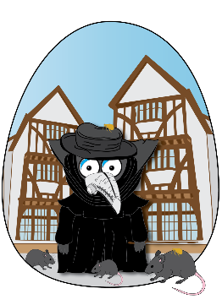
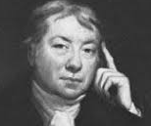
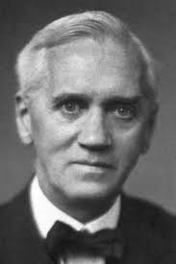
Summer One: Plague, Pox and Antibiotics
Useful Links
Great People
Key Questions
How was the plague transmitted to humans?
How did people during this time think the plague was spread?
What remedies did doctors use for people who had the plague?
What caused the end of the plague?
How was the vaccine for smallpox discovered?
Who discovered Antibiotics?
How was penicillin discovered?
How does modern medicine compare to medicine in the 16th and 17^{t} Century?
1796
Edward Jenner discovered a way to immunise people against
Small Pox
He inoculated an 8 year old boy to create immunity to Smallpox
1928
Alexander Fleming was a microbiologist who discovered Penicillin.
He observed that blob of mould had grown in dirty petri dish.
1348
The First Plague strikes London
1658
Oliver Cromwell dies of Malaria
1665
December- People who fled now return to London
1667
Sir Christopher Wren planned the new city and the rebuilding of London took over 30 years
1928
Penicillin is discovered by Alexander Fleming
1518
First Plague regulations introduced in London
1664
The Plague returns to London
1666
Great Fire of London wipes out most of the disease carrying rats
1948
NHS is formed by Aneurin Bevan
1796
Edward Jenner discovers a Small Pox vaccine
1562
Queen Elizabeth I is struck down with Smallpox
1665
February- Major outbreak in London
1853
Smallpox vaccine is made compulsory in the British Isles
1980
World Health Organisation declares Small Pox eradicated
Here are some of the key dates in History about Plague and Medicine

Slide 2
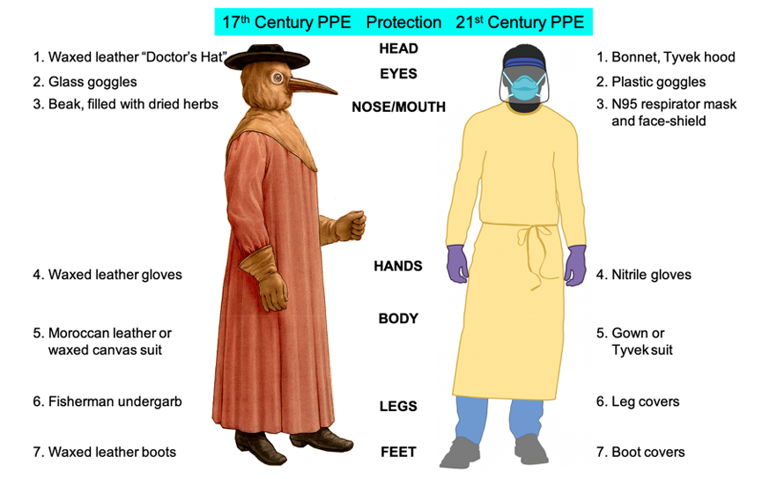
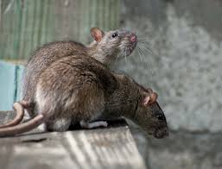
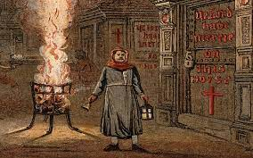

Key Vocab and Glossary
Antibiotics: a medicine (such as penicillin) that inhibits the growth of or destroys microorganisms.
Apothecary: a person who prepared and sold medicines and drugs.
Bacteria: Bacteria, also called germs, are microscopic organisms not visible with the naked eye.
Bubonic Plague: the commonest form of plague in humans, characterized by fever, delirium, and the formation of buboes
Contagious: spread from one person or organism to another, typically by direct contact.
Eradicated: to destroy completely
Herb wife: a woman who sells herbs
Immunisation: the action of making a person or animal immune to infection, typically by inoculation
Infection: the process of infecting or the state of being infected
Inoculation: the action of inoculating or of being inoculated; vaccination.
Microorganism: a microscopic organism, especially a bacterium, virus, or fungus.
Physician: a person qualified to practise medicine
Plague Doctor: A plague doctor was a physician who treated victims of the bubonic plague during epidemics.
Remedies: a medicine or treatment for a disease or injury.
Smallpox: an acute contagious viral disease, with fever and pustules that usually leave permanent scars. It was effectively eradicated through vaccination by 1979
Transmission: the action or process of transmitting something, or the state of being transmitted
Vaccine: a substance used to stimulate the production of antibodies and provide immunity against one or several diseases
Virus: A virus is an infectious agent that can only replicate within a host organism. Viruses can infect a variety of living organisms, including bacteria, plants, and animals. Viruses are so small that a microscope is necessary to visualize them, and they have a very simple structure.
Black rats carried the bacteria that caused the plague. When the rats were bitten by fleas, the fleas then became infected.
The disease was spread through infected fleas biting humans
Red crosses were painted on the doors of those who had symptoms as a warning to stay away.
Those inside were usually infected
Ancient Greece Timeline

