Slide 1

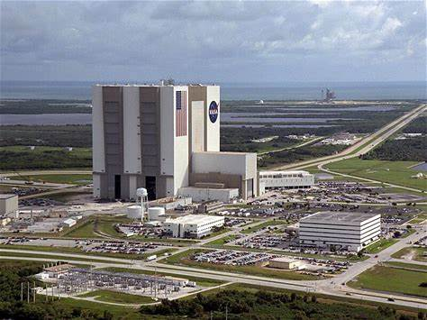
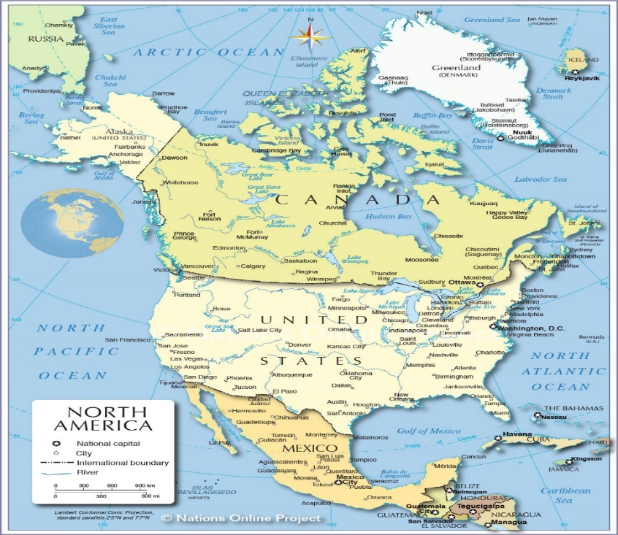
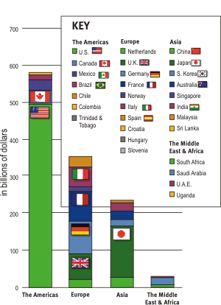
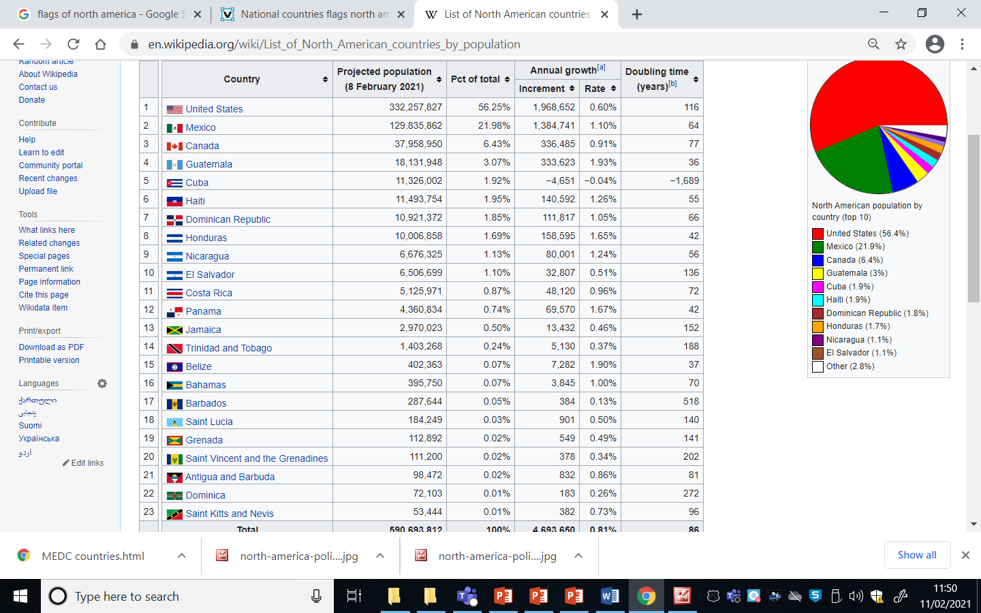
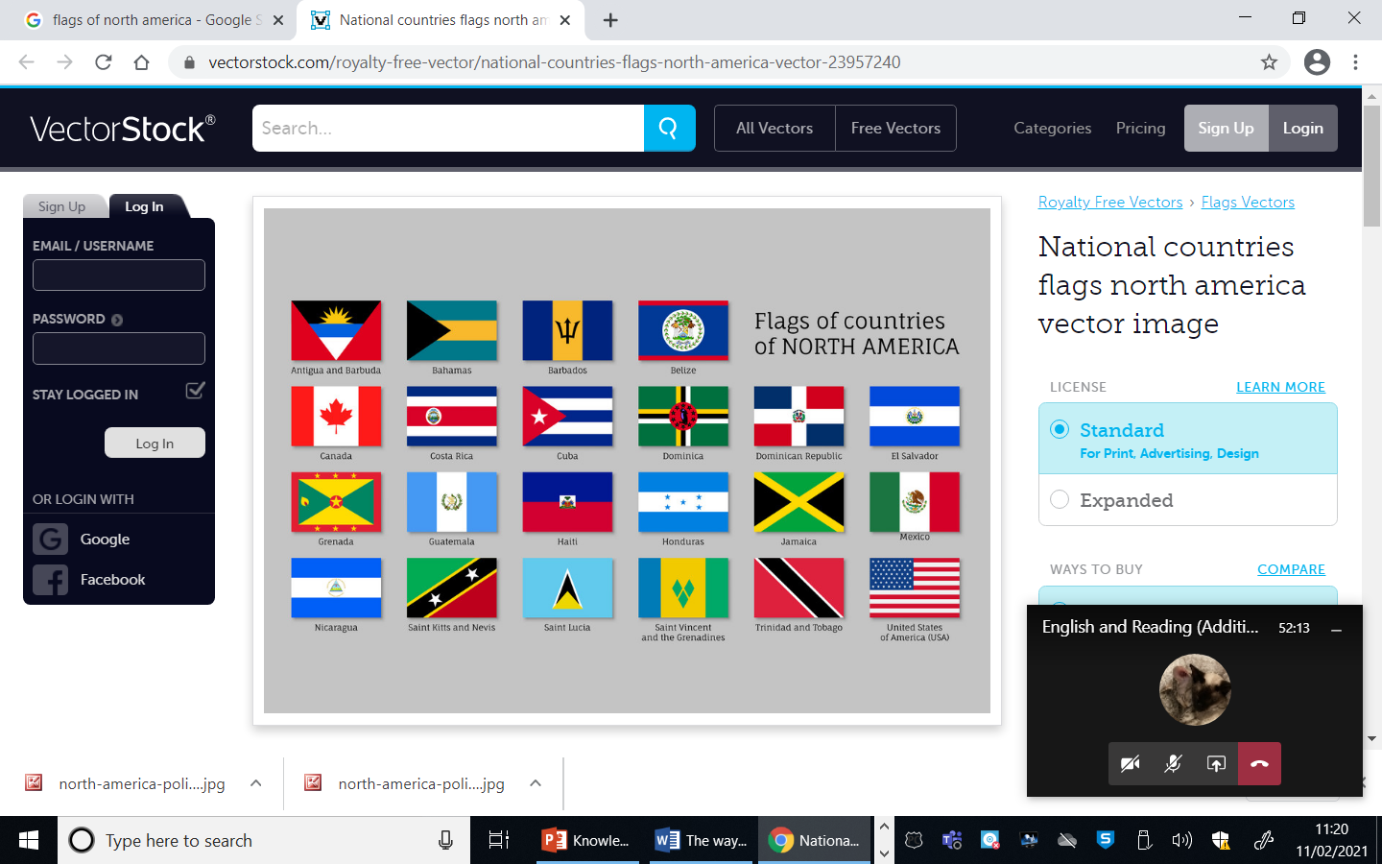
Spring Two: North America
MEDC
stands for More Economically Developed Country
LEDC
stands for Less Economically Developed Country.
Key Questions
Have humans had a positive or negative impact in North America?
Why are people attracted to living in North America?
What are the political establishment in North America?
Is there a rich and diverse culture in North America?
How does Birmingham (USA) differ to Birmingham (UK)
Is North America a MEDC or a LEDC?
Is the population densely or sparsely populated?
Places of National Interest
(Above) Kennedy Space Centre/USA for learning all about space travel and the planets
Houses and Homes
The place you live in is your home, whether it’s a house with four walls and a roof, a flat that’s part of a larger building or a caravan on wheels that can move around. The homes in your city, town or village may look different from yours – this could be because they were built at a different time, and from different materials, also to adapt to the environment.
.

Slide 2
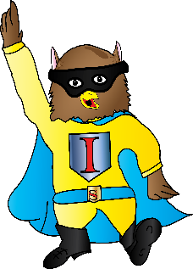
Spring Two: North America
Top 10 Facts!
There are 23 countries in North America with a total of more than 590 million people living on the continent. Largest Country: Canada. The country is covering almost half the North American continent's land area. Canada is slightly bigger than the USA and about as big as China. Largest City: Mexico City, which is the capital city of Mexico with a population of about 9 million. With more than 20 million inhabitants in the city area, this is one of the largest cities in the world. Smallest Country: St Kitts and Nevis with only about 54,000 inhabitants. This island country is located in the Caribbean Sea. The least populated dependency is Montserrat, a British Overseas Territory, with less than 6,000 inhabitants. Longest River of North America: Missouri River/USA (3,767 km/ 2,341 miles). The Missouri River flows through seven states of the USA: Montana, North Dakota, South Dakota, Nebraska, Iowa, Kansas and Missouri. Together with the Mississippi River, it forms one of the largest river systems in the world. | Greenland. This is also the world's largest island that is not a continent! Greenland is located in the North Atlantic Ocean. - Australia is also an island, but considered a continent. Highest Mountain: Denali in Alasaka/USA. The mountain (6,190 metres/ 20,310 ft) is located in the Alaska mountain range. Until 2015, this mountain was referred to as Mount McKinley. English is most widely spoken in North America. Spanish and French are spoken by many as second language in the USA. While Spanish is the most common first language in the Caribbean, French is the first language of 20% of the Canadian population. Biggest Lake: Lake Superior. This is the largest of the Great Lakes in the USA. This lake is as big as South Carolina/USA or Austria! Lake Superior is shared by Canada (to the north) and the United States (to the east, south and west). Lake Superior is also considered the largest freshwater lake by area in the world. Lowest Point: Death Valley. In the Death Valley National Park you will not only find the lowest point in North America with 86 m/282 ft. below sea level, but this is also the hottest and the driest national park in the USA.
Continent one of the seven main land masses on Earth
Environment conditions that surround and influence an organism or community
Agriculture the art and science of cultivating land for growing crops (farming) or raising livestock (ranching).
Climate Change gradual changes in all the interconnected weather elements on our planet.
Colonize to establish control of a foreign land and culture.
Fair-trade having to do with sales that support farmers in developing countries and promote sustainable farming practices.
Human geography the study of the way human communities and systems interact with their environment.
Immigrant person who moves to a new country or region
Mestizo Latin American person with European and Native American ancestry
Metis people and culture native to Canada, who trace their ancestry to European and indigenous heritage.
Ecotourism act and industry of traveling for pleasure with concern for minimal environmental impact
Natural disaster an event occurring naturally that has large-scale effects on the environment and people, such as a volcano, earthquake, or hurricane
Overhunt to capture and kill enough animals to reduce their breeding population below sustainable levels
Nomadic having to do with a way of life lacking permanent settlement
Poverty status of having very little money or material goods.
Prosper to be successful.
Key Vocab and Glossary
Useful Links
North America Facts for Kids | North America | Geography | Superlative (kids-world-travel-guide.com)
North America | BBC Earth | BBC Earth
North America Facts for Kids (easyscienceforkids.com)
North America Continent Facts For Kids | DK Find Out
North America Facts - General Knowledge for Kids | Mocomi

